Slide 1
Nextflow fundamentals training
Albert Palleja Caro
Data Science Platform
27th November 2024

Slide 2
Outline of the theoretical part
What is Nextflow?
Behind nextflow
Why do we need a Community effort?
Nextflow - Basic concepts
Nextflow’s core features
A Nextflow script
Installing Nextflow and running the first scripts
Nextflow and Azure batch
nf-metagenomics pipeline
Resources

Slide 3

Context
Experiments and analyses on large datasets
Portable
Big Data
Reproducible
Workflows: using computers to collect, store and analyze and disseminate data information
Handle small and large files (e.g. genomics)
Many programmimg languages and different softwares
Complex interactions and dependencies between the softwares
Parallellize jobs
Distribute computing
Nextflow addresses these challenges that allow us to build the workflows and has a strong supportive community behind.

Slide 4
Nextflow is a software - Workflow orchestrator engine
Nextflow is a Domain-specific language (DSL) built on top of Groovy
It allows writing data-intensive computational workflows
It accommodates many languages, software environments, and computing environments
It is oriented to bioinformatics analyses
There is an active community giving support, organizing trainings and developing and maintaining 113 different bioinformatics analyses (on date: 27th November 2024)

Slide 5

Behind Nextflow
#Open Science
Make science more open!

Slide 6

Behind Nextflow
Open source
We need to know software, params, options, method used and have access to the source code to be sure of what we are doing.
Nextflow is open source.

Slide 7

Behind Nextflow
Open Data
Which data are we handling?
How was our data measured, which technology generated it, what are the units, etc…
Findable, Accessible, Interoperable, Reusable (FAIR) data

Slide 8

Behind Nextflow
Open community
Nextflow advocates for an open community with multiple channels to interact and connect people, forums, Slack channels, conferences, hackathons regularly organize
nf-core initiative have developed, curate and maintain 118 bioinformatics pipelines

Slide 9

Behind Nextflow
Genomics workflows
First Nextflow pipelines built for Genomics data processing (large files per samples, different formats (binary, tab separated, etc..) parallel processess, different sorftware and languages (python, R, matlab, …) involved, nedd to take decisions for the next processes
Nextflow can handle all that

Slide 10
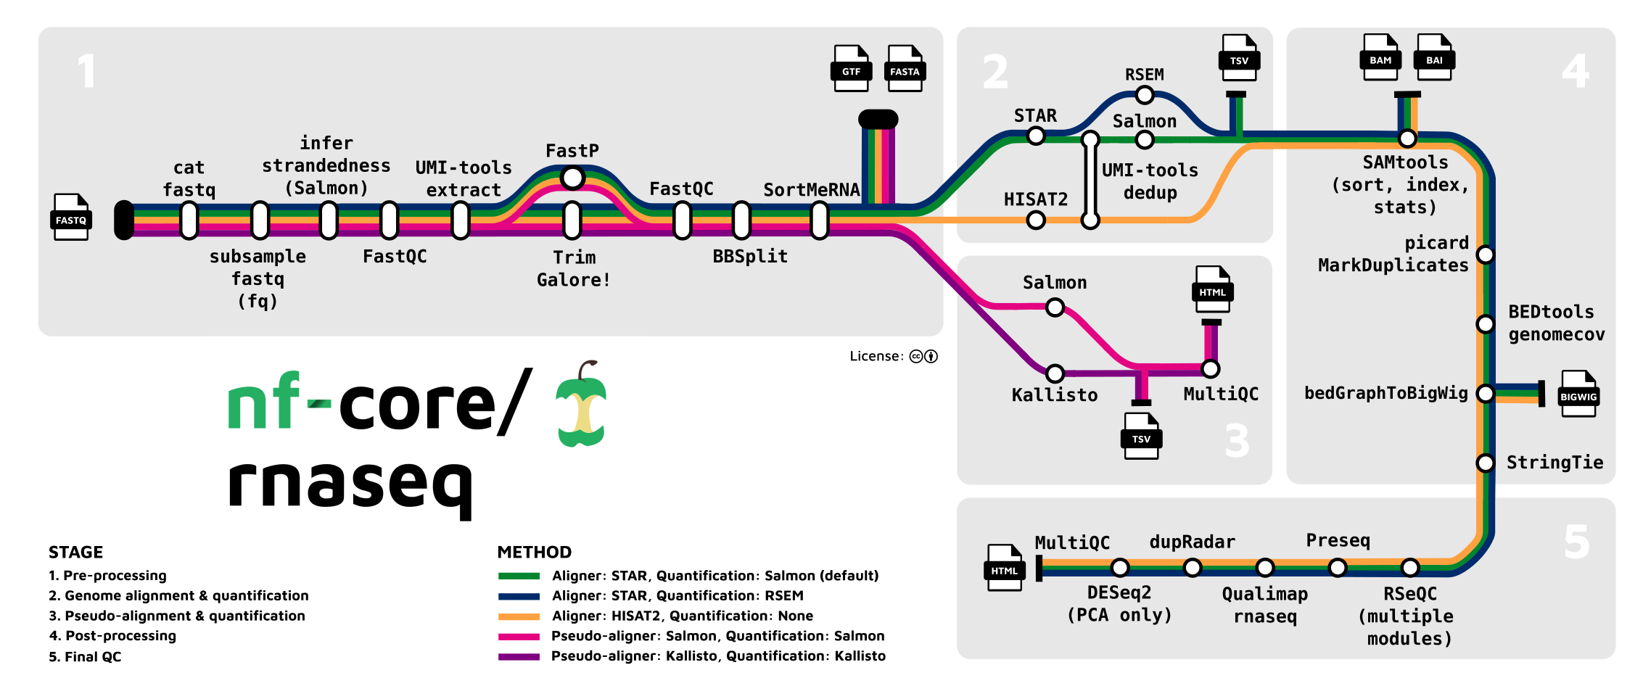
A nextflow pipeline in metro map

Slide 11
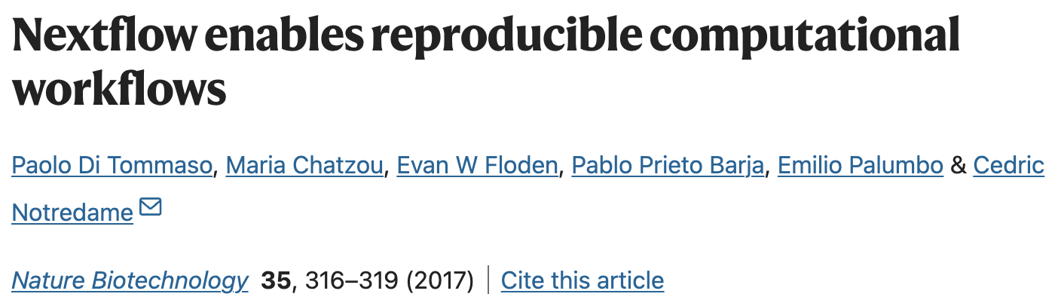
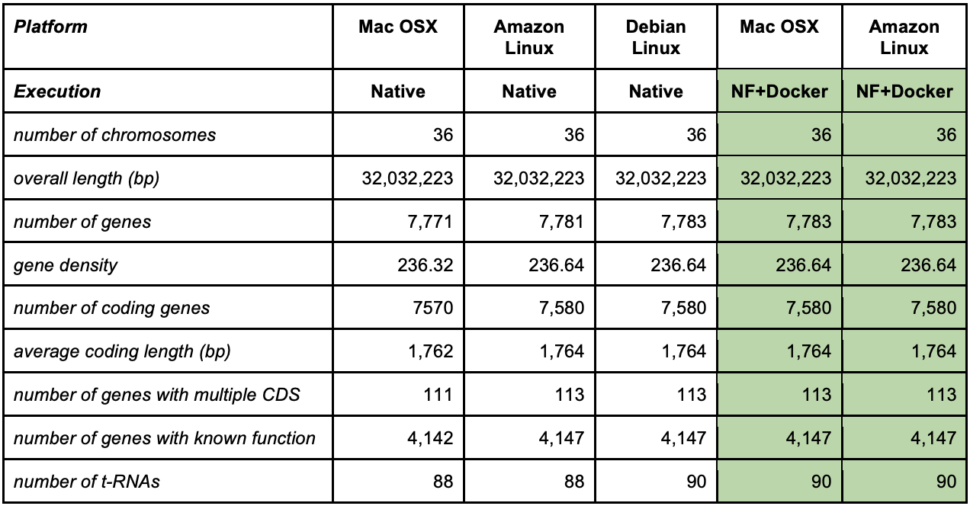
Why do we need a Community effort?
Reproducibility and even repeatability is challenging even if you are very careful keeping the same, params, versions, etc…!!!
Gene annotation differences depending on which operation system the pipeline was executed
This did not happen when using Nextflow + Docker on different environments

Slide 12
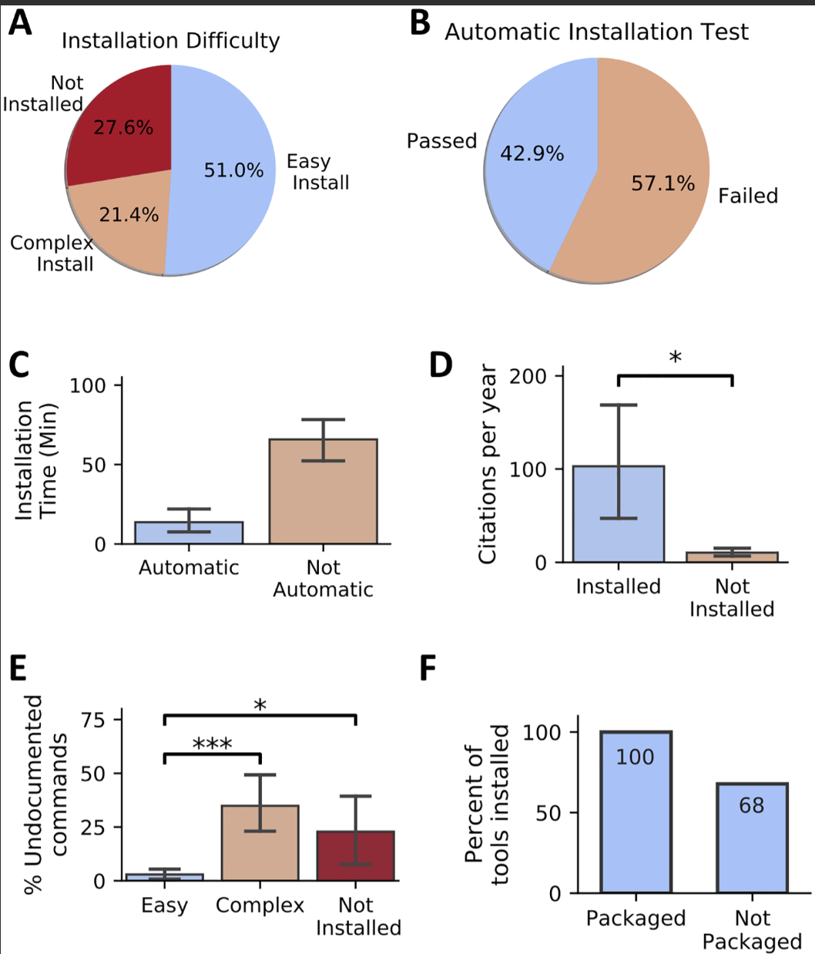
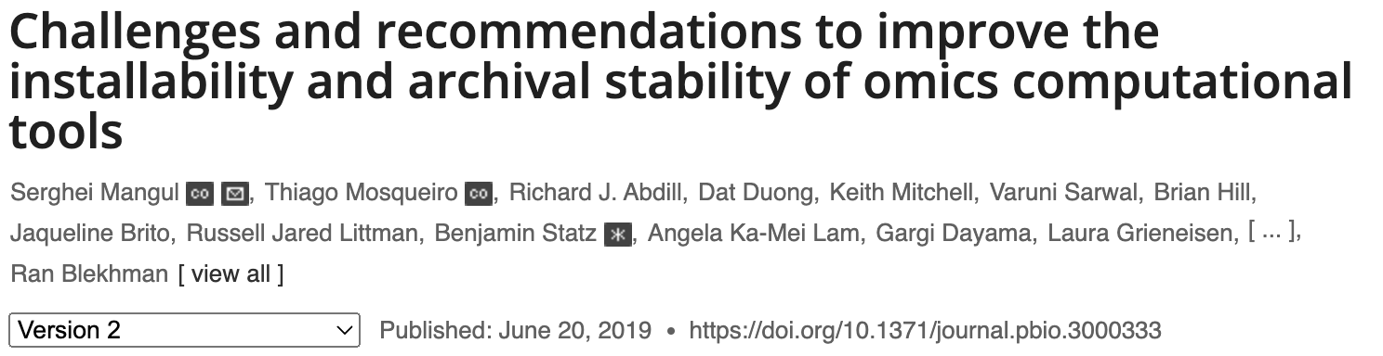
Why do we need a Community effort?
28% of all omics software resources were not accessible through URLs published
Among the tools found, 49% were difficult to install or could not be installed at all!

Slide 13
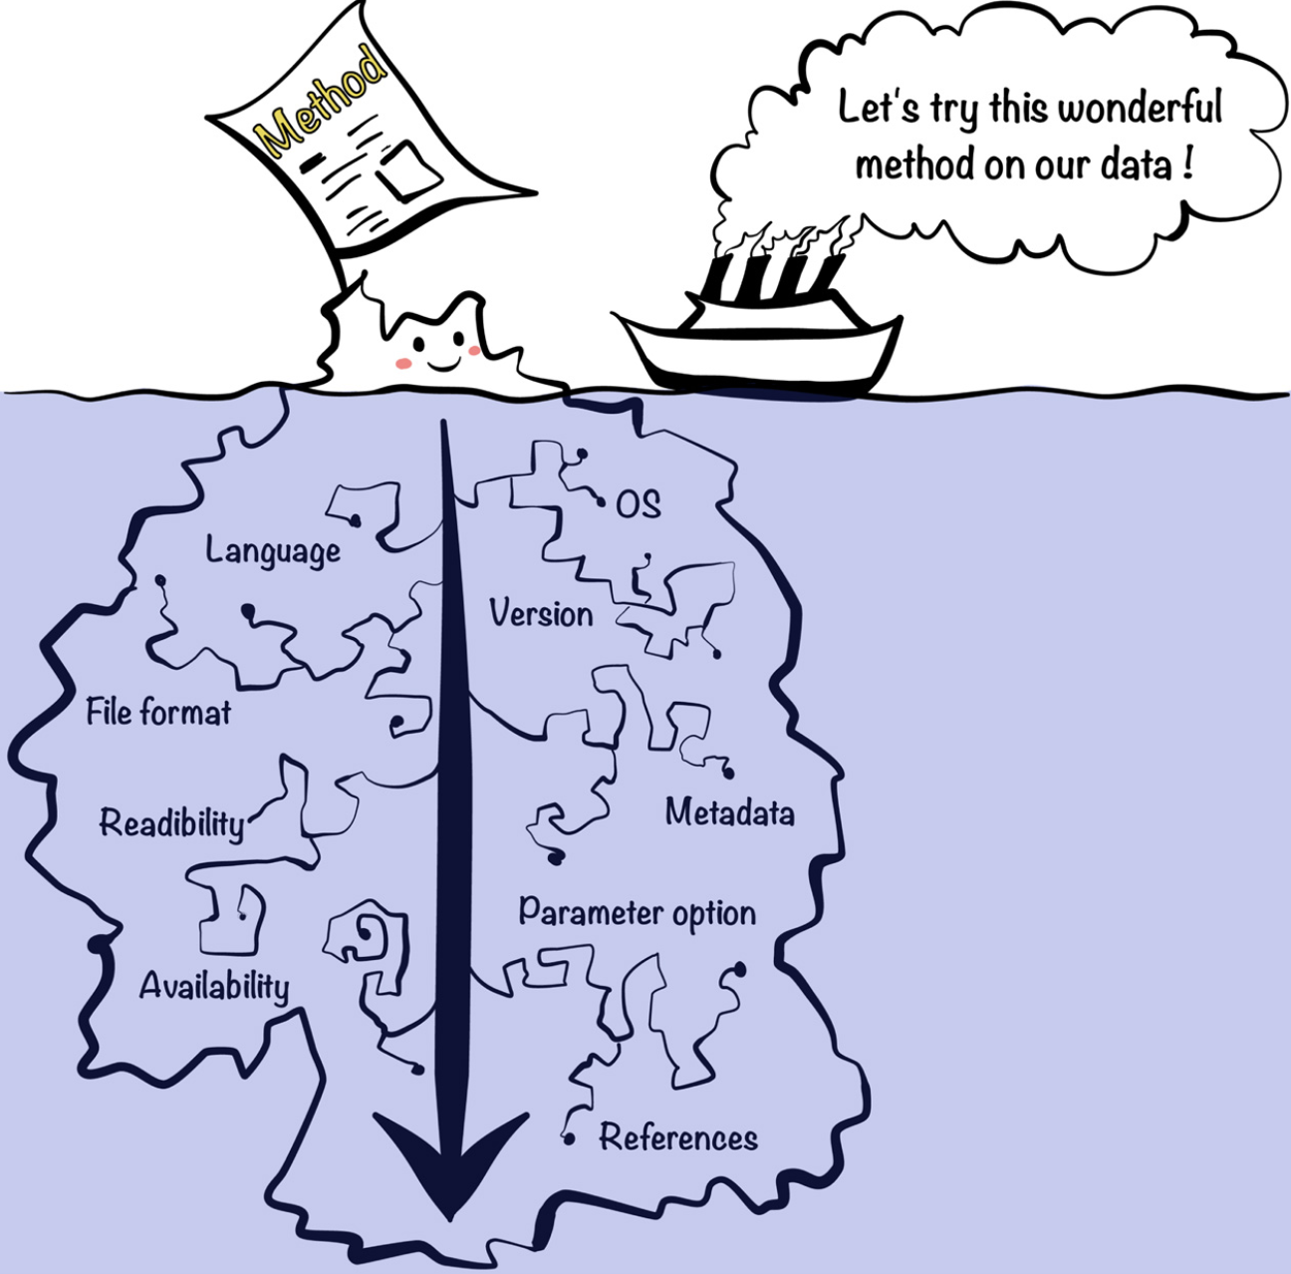

Why do we need a Community effort?
"First we tried to rerun the analysis with the code and the data provided by the authors. Second we reimplemented the whole method in a python package…"

Slide 14
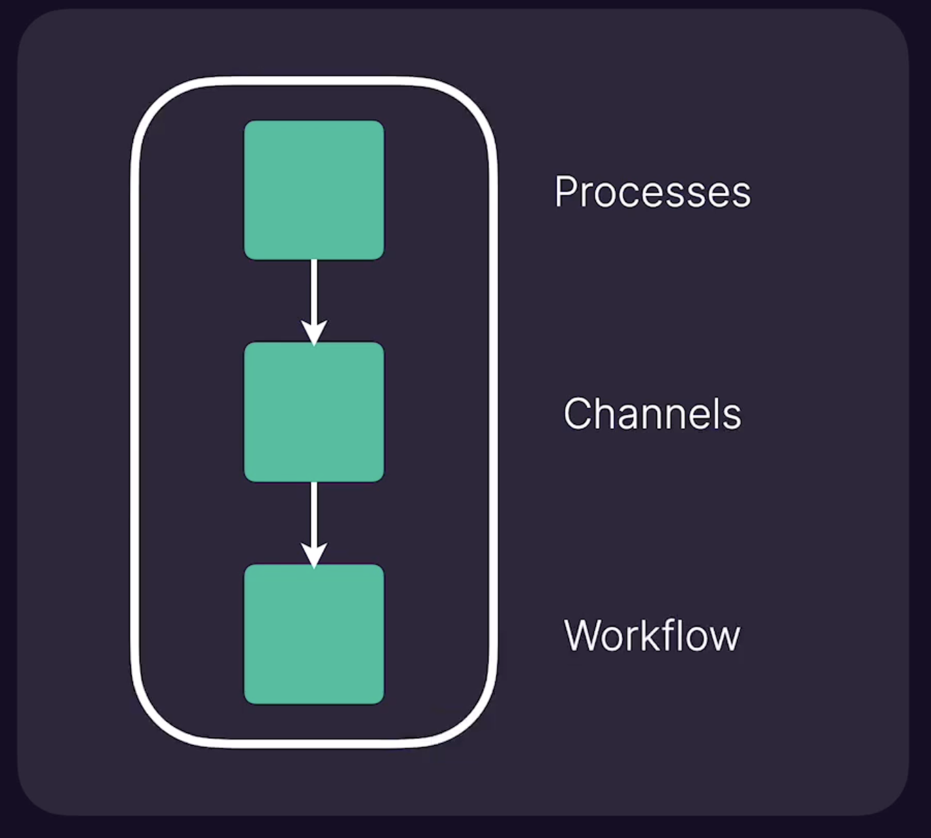
Nextflow is based on few primitives
Process is every step in your pipeline, and they are executed independently isolated from each other
We need something to share inputs and outputs between processes, these are the channels and there are different ways to build those
When you have a set of processes and channels coonecting them we have a workflow

Slide 15
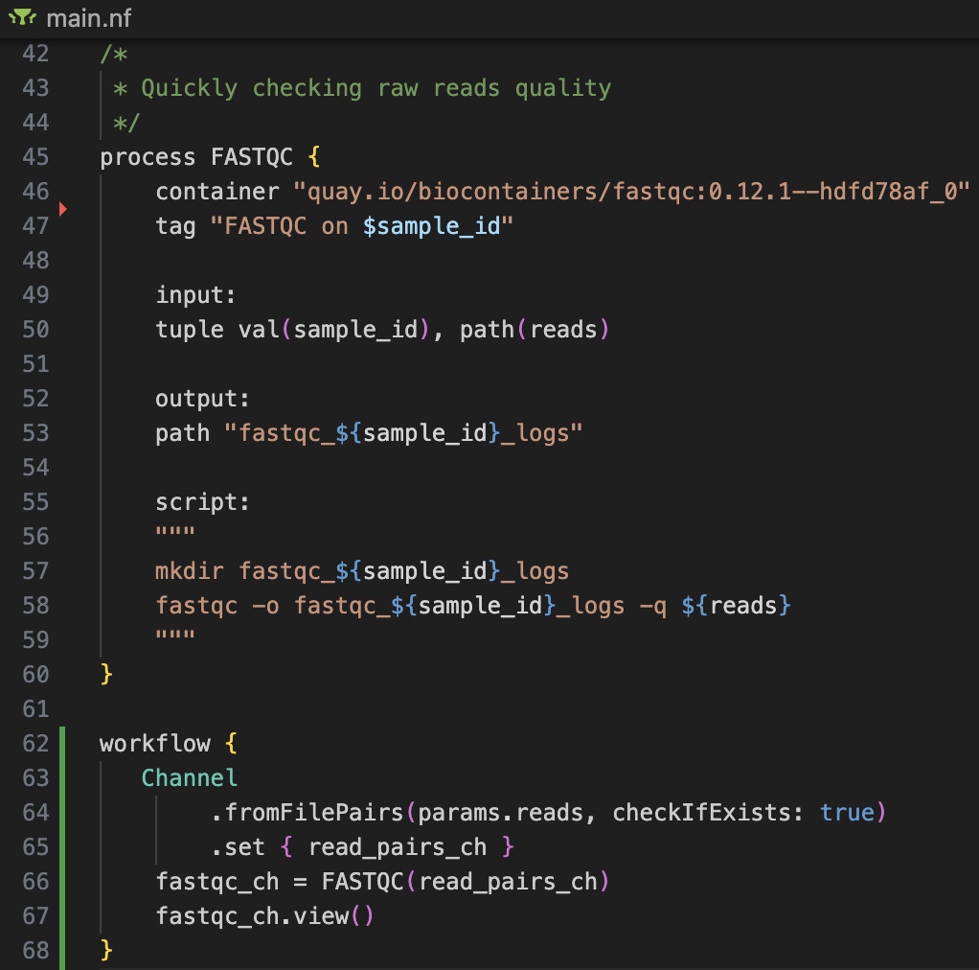
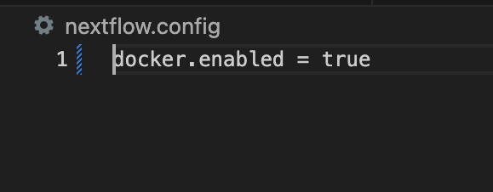
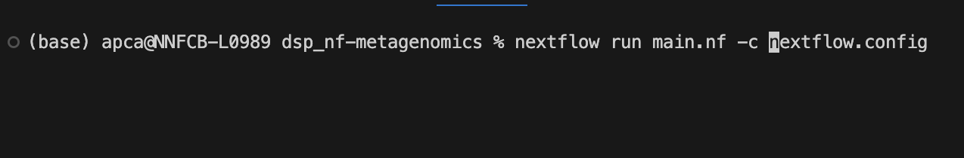
A Nextflow script
The .nf files are workflow scripts
The file nextflow.config is a configuration file that sets minimal environment properties
Directives
Process
Code block
How to run it:
Channel
Workflow

Slide 16
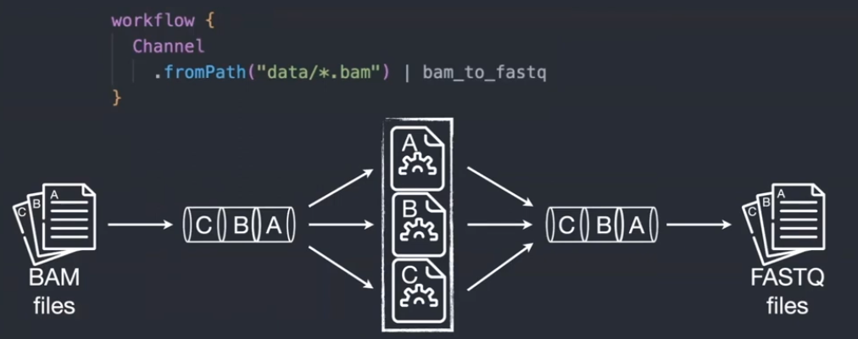
Nextflow – Interesting features
Implicit parallelism (tasks in a process are run by default in parallel)
Reentrancy (resume partial runs, do not need to rerun the entire pipeline when something went wrong, it starts from wherever it stopped)
Reusability (reuse different modules, subworkflows, written and containerized by the Nextflow community)

Slide 17
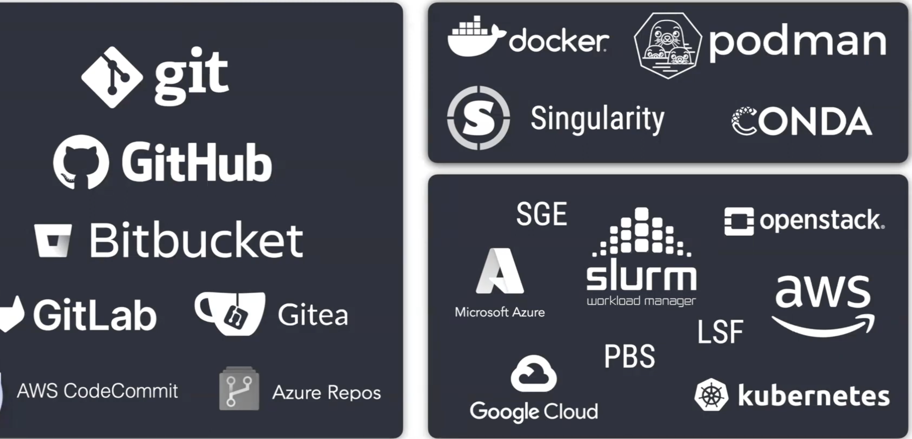
Languages, Software and computing environments
Nextflow it supports many version controlled you can host your code there and run it directly from Nextflow
Nextflow supports most of the containerizing options like Docker, Singularity or Conda environments, etc …
Same thing for computing environments, it supports supports the main cloud infrastructures and most of the job schedulers of HPC
Languages
Software
Compute

Slide 18



Nextflow’s core features
Reproducible between runs
integration with code management tools
all packages downloaded, organized in containers, and control over computing environment
Portable between systems
you can write the code in your laptop and can run everywhere (HPC, cloud)
works with most of computing environments
Scalable
it can be run for 10 on your laptop or thousands of samples in an HPC or the cloud
Integration of existing tools, systems, and industry standards

Slide 19


A global community effort to collect a curated set of open‑source analysis pipelines built using Nextflow. https://nf-co.re/
118 pipelines available (27th November 2024)
to process and analyse many different data types
Modules: 1,163 reusable components that can be integrated into pipelines
Subworkflows: 72 pre-assembled combinations of modules aimed at streamlining commonly used workflows

Slide 20


Tools
Running pipelines
Writing pipelines
Testing/linting
Validating
Automation
Community
Developing with the community
Standards – Use common templates
Best practices defined
Followed globally and through many social media channels (Slack, hackathons,…)
Collaboration – No duplicate pipelines within nf-core
Different modules and subworkflows need to be compatible

